Slide 1
BOOSTING ALGORITHMS IN REGRESSION

Slide 2
ADA BOOST Algorithm -Regression
ADABoost also known as Adaptive boosting, was designed in such a way that at every iteration the sample distribution was adapted to put more weight on misclassified samples and less weight on correctly classified samples.
The final prediction is a weighted average of all the weak learners, where more weight is placed on stronger learners.

Slide 3
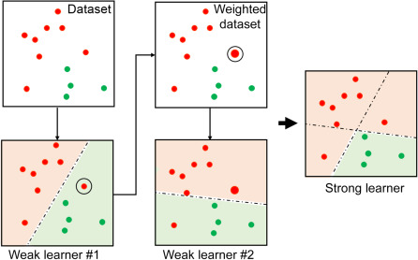
How ADABoost Algorithm works:

Slide 4
Advantages of ADABoost Algorithm
Effectively combine strong base learners (such as deeper decision trees) producing an even more accurate model.
Adaptability: Handles complex classification tasks.
Ease of implementation
Versatility
Handles imbalanced datasets

Slide 5
Disadvantages of ADABoost Algorithm
Sensitive to noisy data
Computationally intensive
Overfitting
Limited flexibility with weak learners

Slide 6
Real Time Apllications of ADABoost
Face detection
Spam filtering
Anomaly detection
Sentimental analysis
Medical diagnosis

Slide 7
XG Boosting Algorithm- Regression
XG Boosting also known as eXtreme Gradient Boosting algorithm in Machine Learning algorithm under ensemble learning.
XGBoost builds a predictive model by combining the predictions of multiple individual models, often decision trees in iterative manner.
The algorithm works by sequentially adding weak learners to the ensemble, with each new learner focussing on correcting the errors made by the existing ones.
It uses a gradient descent optimization technique to minimize a predefined loss function during training.

Slide 8
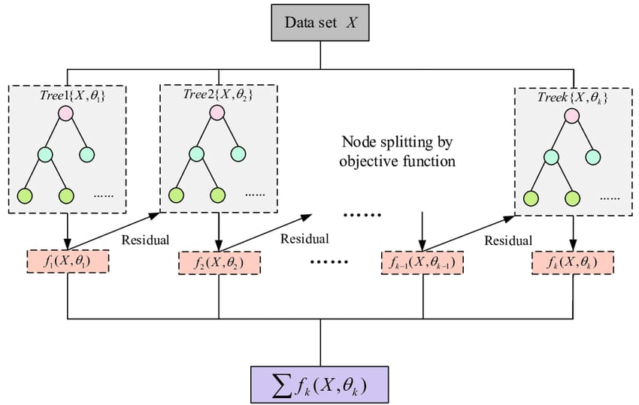
How XGBoost Algorithm works:

Slide 9
Benefits of XGBoost Algorithm
Can handle large, complex datasets
Can handle missing data
Can work well with non-linear, non-monotonic, or segregated data
Can be tuned to improve model performance
Uses regularization techniques to prevent overfitting

Slide 10
Disadvantages of XGBoost Algorithm
Complexity
Computational resources
Hyperparameter tuning

Slide 11
Real Time Applications of XGBoost
Predictive modelling
Time series forecasting
Customer churn prediction

Slide 12
LGBoosting Algorithm- Regression
LGBoost also known as Light Gradient Boosting Machine Algorithm, is a regression model made up of n_estimators (default value=100) relatively small decision trees that are called weak learners, or sometimes base learners.
The weak learners are constructed sequentially where each tree uses gradients of the error from the previous tree.
Gradient boosting regression calculates the difference between the current prediction and the known correct target value.
In contrast to the level-wise (horizontal) growth in XGBoost, LightGBM carries out leaf-wise (vertical) growth that results in more loss reduction and, in turn, higher accuracy while being faster

Slide 13
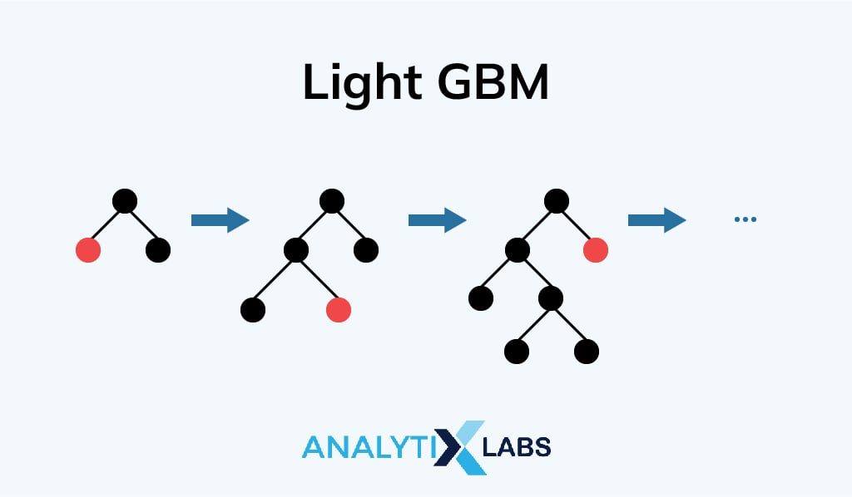
How LGBoost Algorithm works:

Slide 14
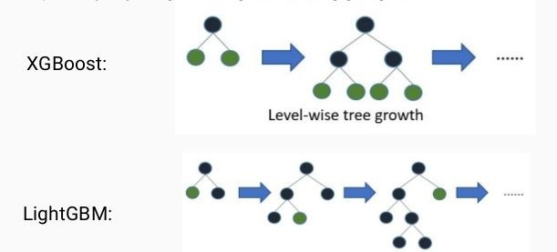
Difference between XGBoost and LightGBM Boost Algorithms:

Slide 15
Advantages of LGBoost Algorithm
Faster training speed and higher efficiency
Lower memory usage
Better accuracy than any other boosting algorithm
Compatability with large datasets

Slide 16
Disadvantages of LGBoost Algorithm
Overfitting
Compatibility with smaller datasets

Slide 17
Real Time Applications of LGBoost
Fraud detection
Image and speech recognition
Personalized recommendation systems
Online advertising
Self-driving cars
Marketing

Slide 18
Thank you….

